Slide 1
Clustering Analysis using Unsupervised Learning and Time Series Forecasting Models
By Yudhishtar Charan

Slide 2
Data Overview
Feature Name | Description | Description
date | Date of the weather observation. The format is YYYY-MM-DD. | Date of the weather observation. In sequence and unique.
meantempm | Mean temperature in degrees Celsius. | 2 peaks in KDE, no major outliers
meandewptm | Mean dew point temperature in degrees Celsius. | 2 peaks in KDE,no major outliers
meanpressurem | Mean atmospheric pressure in millibars. | 2 peaks in KDE,no major outliers
maxhumidity | Maximum humidity percentage during the day. | 2 peaks in KDE,no major outliers
minhumidity | Minimum humidity percentage during the day. | 1 peak in KDE, outliers are present.
maxtempm | Maximum temperature in degrees Celsius. | 1 peak in KDE, no major outliers
mintempm | Minimum temperature in degrees Celsius. | 2 peaks in KDE, outliers are present.
maxdewptm | Maximum dew point temperature in degrees Celsius. | 2 peaks in KDE,no major outliers
mindewptm | Minimum dew point temperature in degrees Celsius. | 2 peaks in KDE,no major outliers
maxpressurem | Maximum atmospheric pressure in millibars. | 2 peaks in KDE,no major outliers
minpressurem | Minimum atmospheric pressure in millibars. | 2 peaks in KDE,no major outliers
precipm | Precipitation in millimeters. | 1 peak and a lot of outliers are present.

Slide 3
Data cleaning and formatting
The data is of the shape (679, 13).
All variables apart from date (which is in object format) are in number format (int/float). We will need to change the date to datetime format.
No nans and duplicates

Slide 4
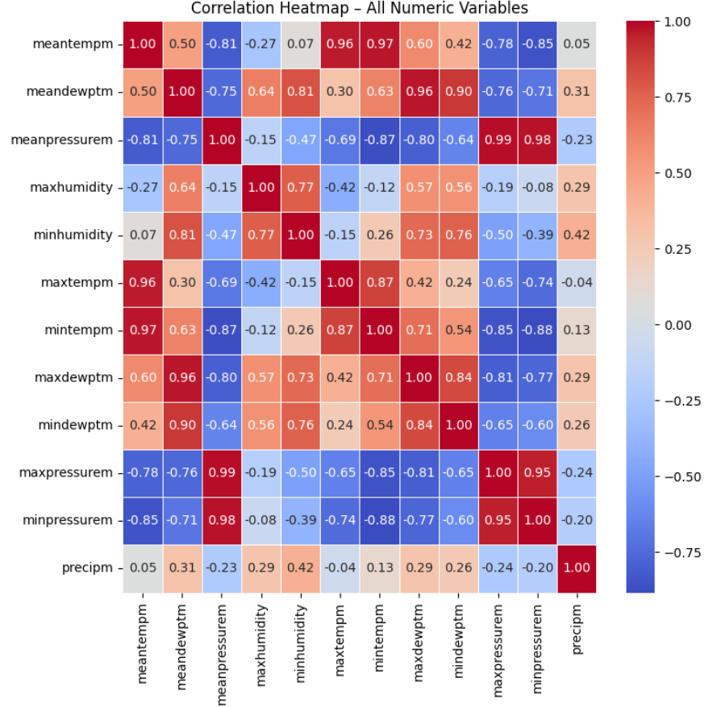
Bivariate analysis
Temperature and pressure have a strong negative relationship, meaning hot days usually come with lower pressure.
Temperature and humidity also move in opposite directions, so when the temperature rises, the air tends to feel drier.
Minimum temperature and dew point show a strong positive link, which means nights stay warmer when there is more moisture in the air.
We also found that pressure and humidity are weakly related, with higher-pressure days being slightly drier.
Precipitation and humidity show a small positive relationship, which makes sense because higher humidity increases the chances of rain.

Slide 5
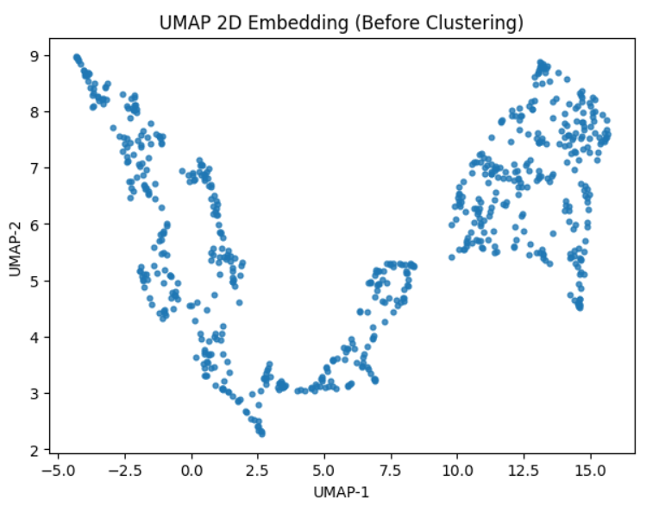
2D projection of data using UMAP

Slide 6
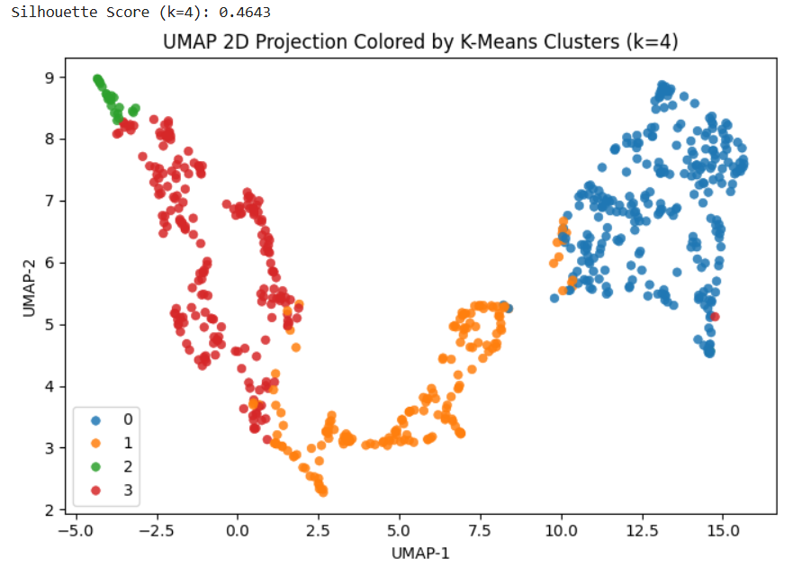
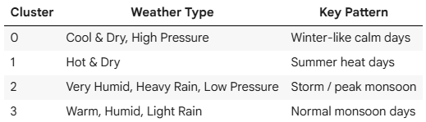
Clustering Results: KMeans (4 clusters)

Slide 7
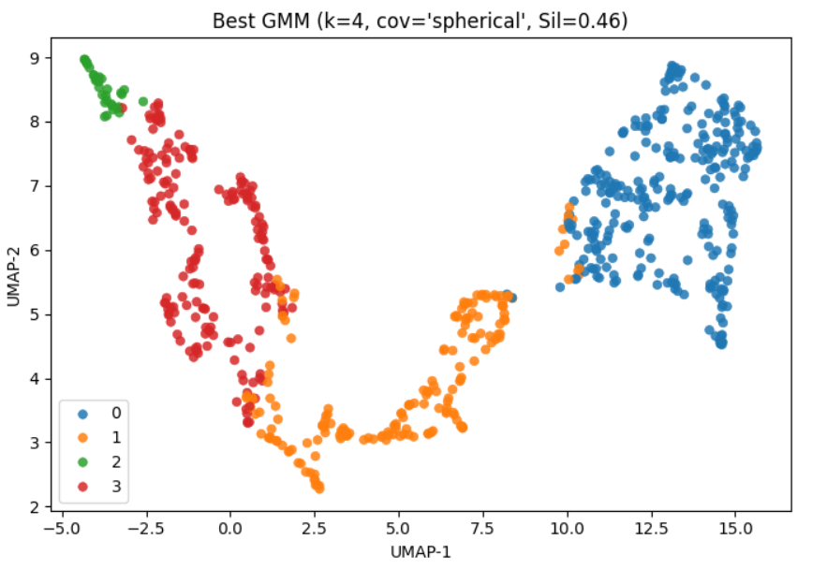
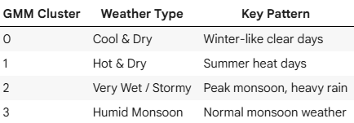
Clustering Results: GMM (4 clusters)

Slide 8
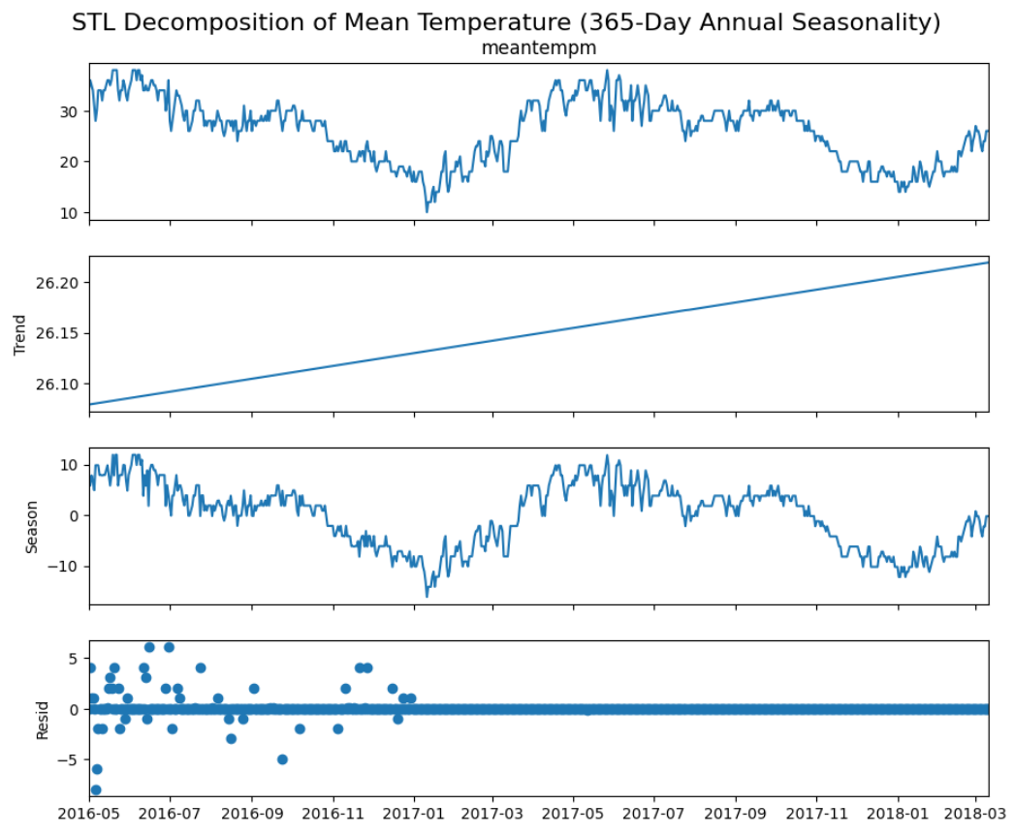
Decomposing Trend, Seasonality and residue
The trend is almost flat.
Mean temperature has a strong annual seasonal pattern
Residuals show the expected noise after removing partial seasonality and weak trend.

Slide 9
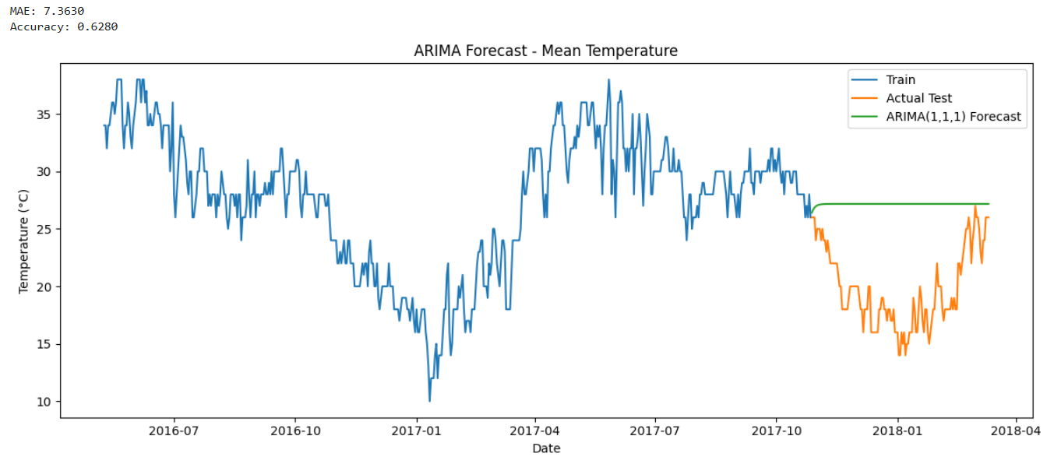
ARIMA to predict mean temperature

Slide 10
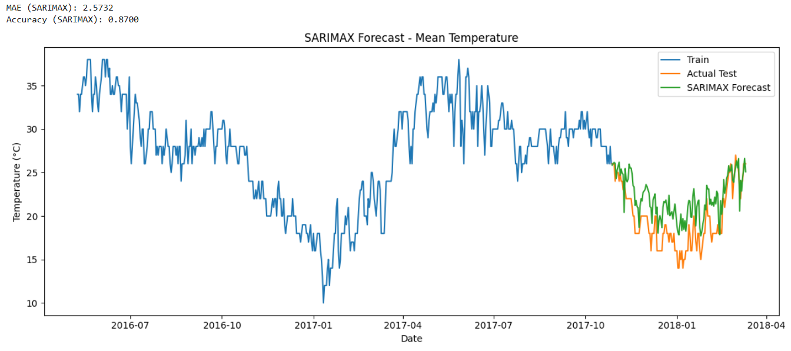
SARIMAX to predict mean temperature

Slide 11
Thank You

